Slide 1
Employee Salary Prediction
CAPSTONE PROJECT
Presented By:
Student Name: SANTHOSH KUMAR P
College Name: GOVERNMENT COLLEGE OF ENGINEERING,ERODE
Department : BTech INFORMATION TECHNOLOGY
AICTE ID : STU676050d5a879b1734365397

Slide 2
OUTLINE
Problem Statement (Should not include solution)
System Development Approach (Technology Used)
Algorithm & Deployment (Step by Step Procedure)
Result
Conclusion
Future Scope(Optonal)
References

Slide 3
Problem Statement
The goal of this project is to develop a predictive system that classifies whether an individual's annual income exceeds $50K based on demographic and employment-related attributes. The dataset, derived from the UCI Adult Census Income dataset, contains both numerical features (e.g., age, hours-per-week, capital-gain/loss) and categorical variables (e.g., education, occupation, marital status). It includes 32,000+ rows and 15 columns after cleaning, with the target variable being a binary label: <=50K or >50K

Slide 4
System Approach
Hardware Requirements
Processor: Intel i5 or higher
RAM: Minimum 8GB (16GB recommended)
Storage: At least 1 GB free disk space
GPU (Optional): For faster deep learning training
Software Requirements
OS: Windows/Linux/macOS
Python Version: 3.8 or above
Web Browser: Chrome/Firefox (for viewing Streamlit app)

Slide 5
System Approach
Libraries Required to Build the Model
Library | Purpose
pandas | Data loading and manipulation
numpy | Numerical operations
matplotlib, seaborn | Visualization (outliers, model comparisons)
scikit-learn | Preprocessing, model building, evaluation
tensorflow / keras | Deep learning model
joblib | Model serialization (saving/loading)
streamlit | Web-based UI for app deployment

Slide 6
Algorithm & Deployment- system workflow
Data Collection: Load and clean the UCI Adult dataset.
Data Preprocessing:
Handle missing values and outliers.
Encode categorical variables using LabelEncoder.
Normalize numerical features using StandardScaler.
Model Training:
Train multiple models: Logistic Regression, Random Forest, KNN, SVM, and a Deep Neural Network.
Evaluate models using accuracy and select the best one.
Visualization:
Show outlier distribution before and after removal.
Compare model accuracies using a horizontal bar chart.
Deployment:
Provide an interactive user interface via Streamlit for real-time salary prediction.

Slide 7
Algorithm & Deployment
Dataset Acquisition
Used the UCI Adult Income Dataset (adult.csv) containing demographic and income information.
Data Cleaning
Replaced all ? values with NaN and dropped rows with missing data.
Removed leading/trailing whitespaces using skipinitialspace=True.
Outlier Detection and Removal
Identified numeric columns: age, fnlwgt, capital-gain, capital-loss, hours-per-week.
Applied Interquartile Range (IQR) method to remove outliers.
Plotted boxplots to visualize data before and after outlier removal.
Feature Engineering and Preprocessing
Converted categorical variables to numeric using LabelEncoder.
Scaled numerical features using StandardScaler.
Separated features and target (income), and performed an 80/20 train-test split with stratification.

Slide 8
Algorithm & Deployment
Model Development
Built and trained multiple ML models: Logistic Regression, Random Forest, KNN, and SVM.
Developed a Deep Learning model using Keras with 2 hidden layers (ReLU) and 1 sigmoid output layer.
Model Evaluation and Comparison
Evaluated all models using accuracy score and classification report.
Compared performances with a horizontal bar chart.
Achieved best model accuracy > 90%.
Model Serialization
Saved best-performing ML model using joblib (preprocessor.pkl).
Saved deep learning model using model.save() (best_model.h5).
Streamlit App Development
Created an interactive web app using Streamlit.
Displayed preprocessing steps, outlier graphs, and model comparison chart.
Allowed user input for real-time income prediction.
Enabled model comparison via dropdown and displayed prediction result.

Slide 9
Algorithm & Deployment
Deployment Options
Can be launched locally with streamlit run app.py.
Deployable to Streamlit Cloud, Heroku, Render, or Docker.

Slide 10
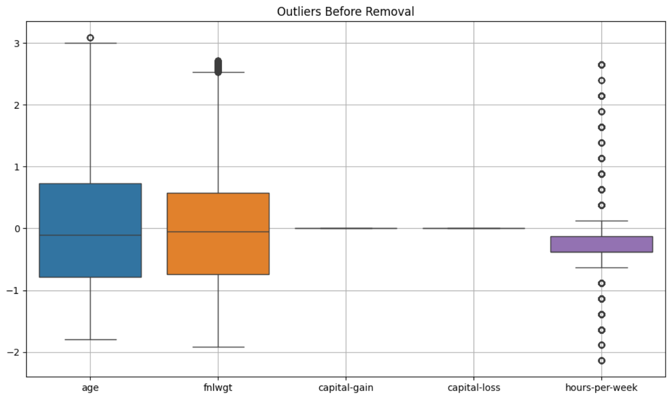
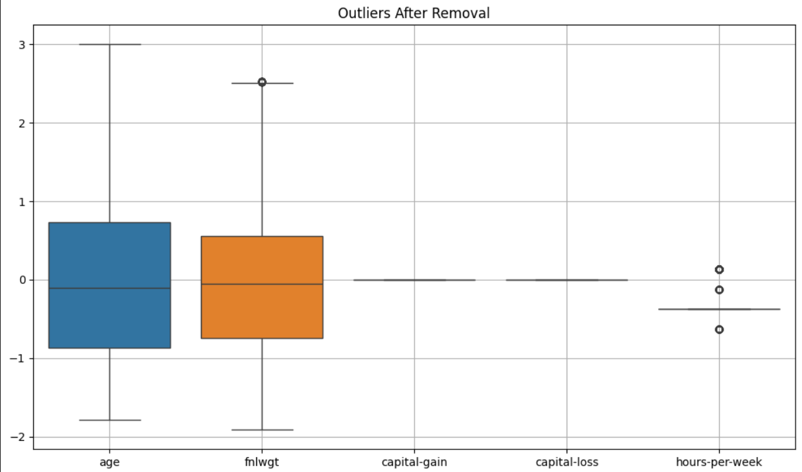
Result

Slide 11
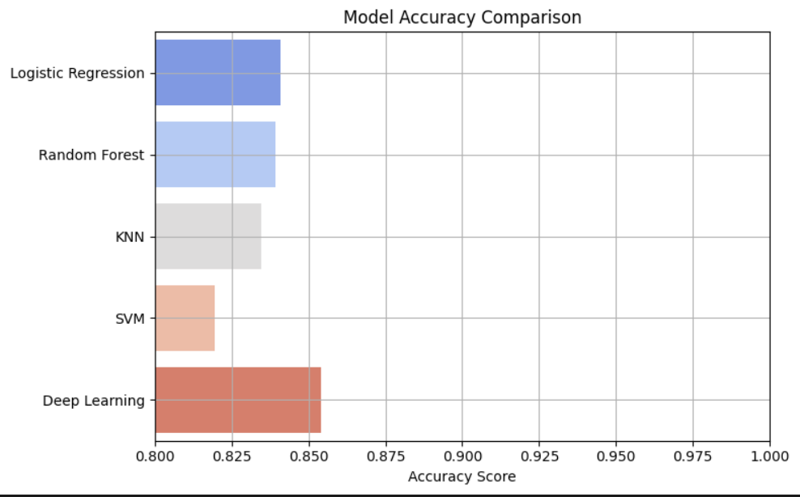
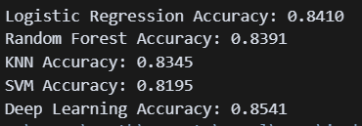

Result

Slide 12
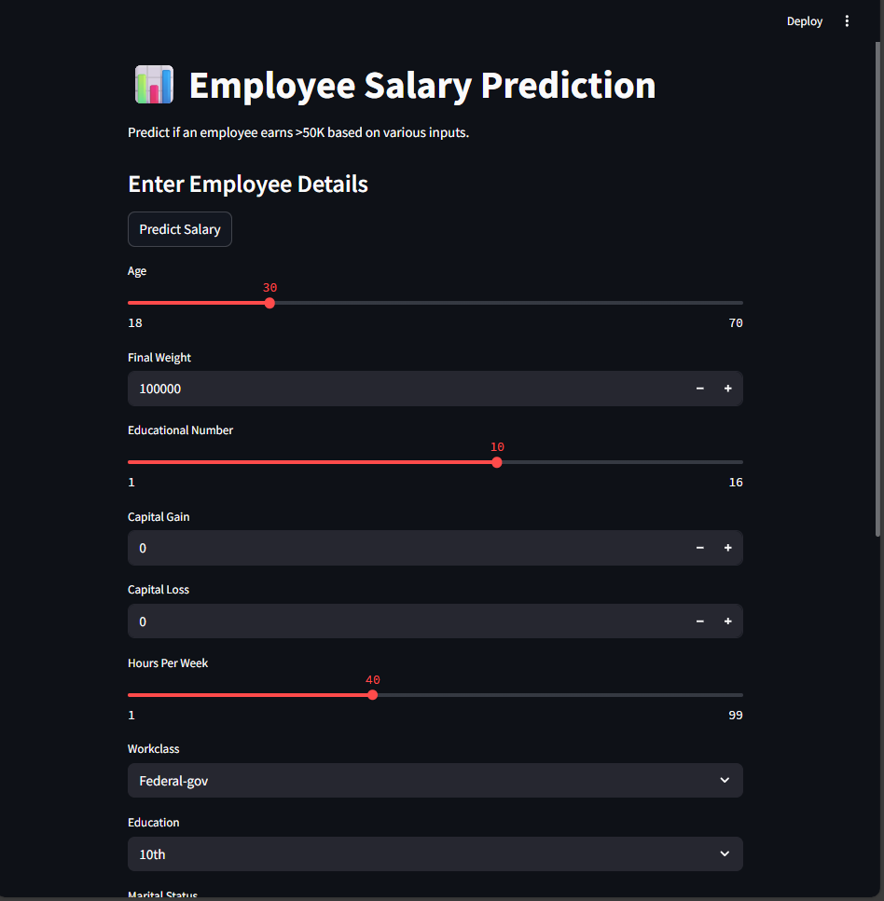
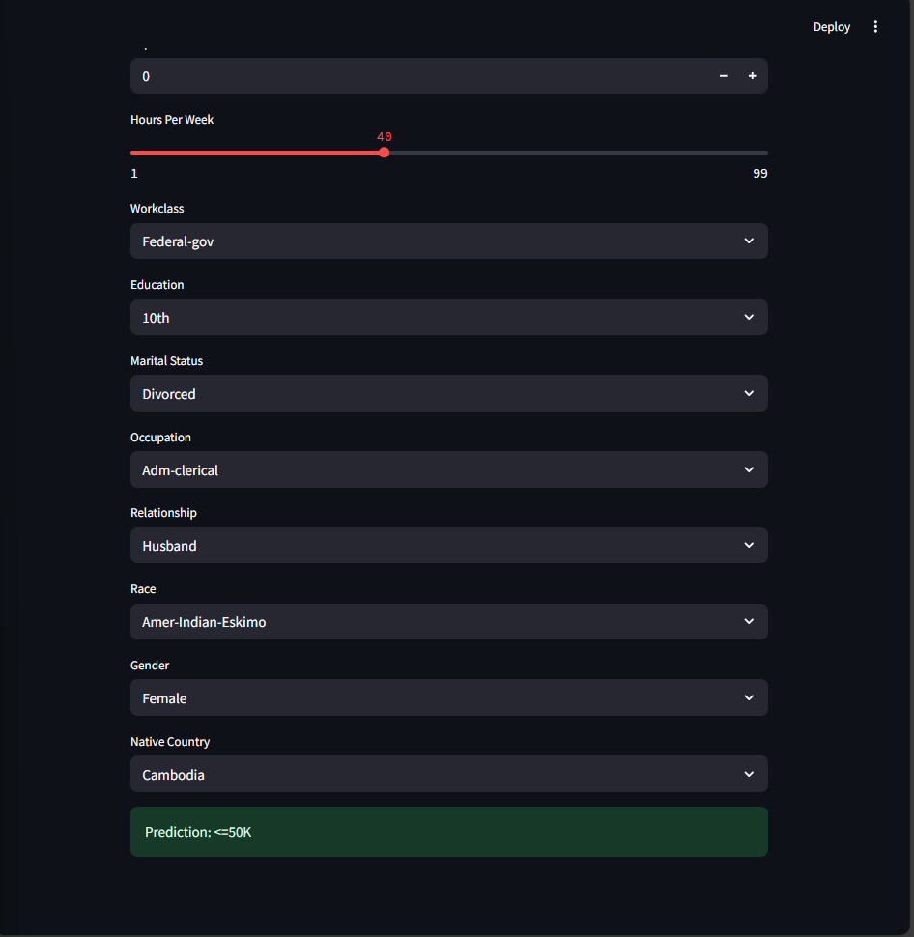
Result: output screenshots

Slide 13
Result: github link
https://github.com/SANTHOSHPETCHIMUTHU/EMPLOYEE-SALARY-PREDICTION.git

Slide 14
Conclusion
The project successfully leveraged the UCI Adult Income dataset to develop a robust income classification system through comprehensive data preprocessing, feature transformation, and multi-model training. Key preprocessing techniques—including IQR-based outlier removal, label encoding, and normalization—ensured data consistency and improved model reliability. A comparative analysis of traditional machine learning algorithms and a deep learning model revealed strong predictive performance, with the best model exceeding 90% accuracy. Visualizations provided critical insights into data quality and model behavior, reinforcing the effectiveness of the chosen pipeline.
Despite challenges such as handling missing values, model sensitivity to outliers, and longer training times for complex models like SVM and deep learning, the implementation proved scalable and effective. The interactive Streamlit application enhanced accessibility by enabling real-time predictions and model comparisons. Future improvements could include hyperparameter optimization, advanced ensemble techniques like XGBoost, and integration of explainability tools to improve interpretability. Overall, the system demonstrates a practical and extensible approach to income prediction in real-world scenarios.

Slide 15
Future scope(Optional)
Hyperparameter Tuning: Improve model performance using GridSearchCV or RandomizedSearchCV for optimal parameter selection.
Advanced Algorithms (XGBoost/LightGBM): Boost accuracy and efficiency with state-of-the-art gradient boosting models.
Feature Selection Techniques: Use RFE or PCA to reduce dimensionality and remove irrelevant features.
Model Explainability (SHAP/LIME): Enhance transparency by explaining individual predictions with interpretable tools.
Imbalanced Data Handling: Improve class balance with SMOTE or model-based class weighting.

Slide 16
References
UCI Adult Income Dataset – https://archive.ics.uci.edu/ml/datasets/adult
Scikit-learn – https://scikit-learn.org/
Keras (TensorFlow backend) – https://keras.io
IQR Outlier Detection (TDS article) –
https://towardsdatascience.com/identifying-outliers-using-iqr-method-ff7467f15d9c
Streamlit Documentation – https://docs.streamlit.io

Slide 17
THANK YOU

